Slide 1
WEEK 3
System Design(SD)(22CS024)
Bachelor of Engineering- Computer Science & Engineering
Department of Computer Science & Engineering
Chitkara University Institute of Engineering and Technology, Chitkara University, Punjab, India

Slide 2
CAP Theorem
The CAP Theorem, also known as Brewer's Theorem, is a fundamental principle in distributed system design introduced by computer scientist Eric Brewer in 2000. It asserts that a distributed data store can provide at most two of the following three guarantees simultaneously:
Consistency (C): Every read operation returns the most recent write result, ensuring all nodes have the same data at any given time.
Availability (A): Every request (read or write) receives a response, even if some nodes are unavailable.
Partition Tolerance (P): The system continues to operate correctly even if network partitions (communication failures) occur between nodes.

Slide 3
The theorem implies that during network partitions, a system must choose between consistency and availability. This trade-off is critical in designing distributed systems, especially as network failures are inevitable.
System Types Based on CAP
Distributed systems are often categorized based on which two properties they prioritize:
CP (Consistency and Partition Tolerance): These systems ensure data consistency and can tolerate network partitions but may become unavailable during such partitions. Examples include relational databases like MySQL and PostgreSQL

Slide 4
AP (Availability and Partition Tolerance): These systems remain available and can tolerate network partitions but may return stale data. Examples include NoSQL databases like Cassandra and DynamoDB.
CA (Consistency and Availability): These systems ensure data consistency and availability but cannot tolerate network partitions. This model is often theoretical, as most distributed systems must handle partitions.

Slide 5
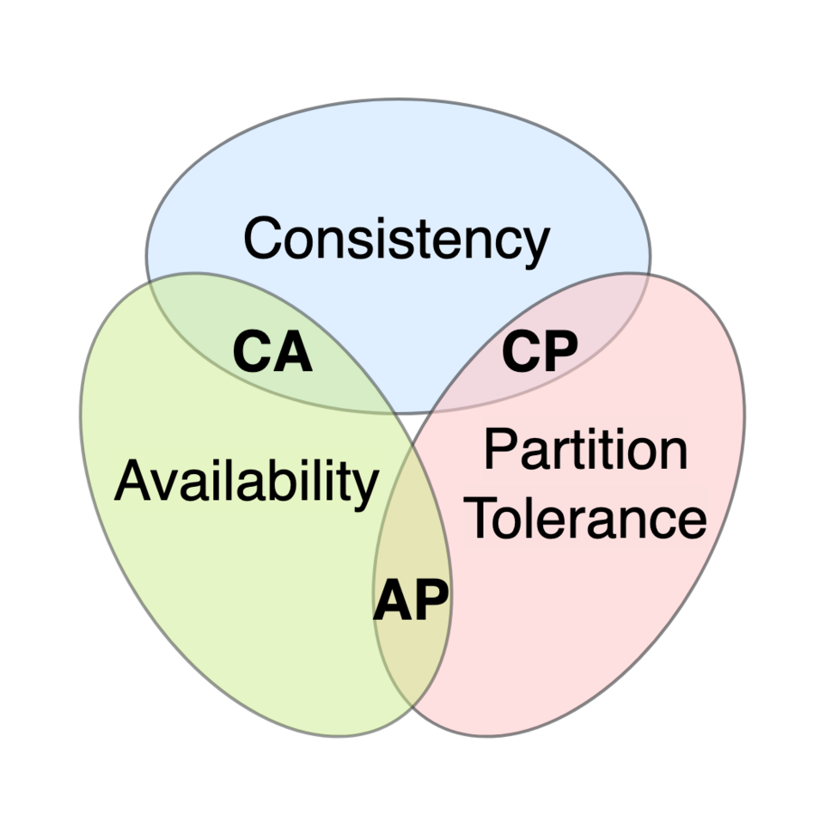

Slide 6
Practical Implications
In practice, the CAP Theorem guides architects in making informed decisions about system design:
Financial Applications: Systems like banking require strong consistency to ensure accurate transactions, often opting for CP systems.
E-commerce Platforms: These prioritize availability to handle high traffic, even at the cost of eventual consistency, favoring AP systems.
Understanding the CAP Theorem helps in selecting the appropriate database and architecture based on the specific needs and trade-offs of the application.

Slide 7
CONSISTENCY PATTERNS:
In distributed systems, consistency refers to the guarantee that all nodes in the system reflect the same data at any given time. Different consistency models offer varying trade-offs between data accuracy, system performance, and availability.
1. Strong Consistency
Ensures that after a write operation, all subsequent read operations will return the most recent write, regardless of which node is queried.
Characteristics:
All nodes have the same data at all times.
Operations are sequentially ordered.
May introduce latency due to synchronization across nodes.

Slide 8
Use Cases:
Financial transactions.
Inventory management systems.
Authentication and authorization services.
Example: Amazon S3 now provides strong consistency,
ensuring that once a file is written,
all subsequent reads will reflect that write immediately.

Slide 9
2. Eventual Consistency
Guarantees that, given enough time without new updates, all replicas of a data item will converge to the same value.
Characteristics:
Temporary inconsistencies are allowed.
Suitable for systems where absolute accuracy isn't critical at all times.
Offers high availability and partition tolerance.
Use Cases:
Social media feeds.
Product catalog updates.
User activity tracking.
Example: In a social media platform, when a user updates their profile picture, it might take some time for all users to see the new image due to eventual consistency.

Slide 10
3. Weak Consistency
Provides no guarantees about when or whether all replicas will converge to the same value.
Characteristics:
Allows for significant temporary inconsistencies.
Suitable for systems where performance and availability are prioritized over data accuracy.
Often used in caching mechanisms.
Use Cases:
Session storage.
Caching layers in web applications.
Real-time analytics dashboards.
Example: A caching layer might serve outdated data temporarily to ensure fast response times, even if the data isn't immediately consistent with the primary database.

Slide 11
Choosing the Right Consistency Model
Based on your Application Requirement:
Strong Consistency: Opt for this when data accuracy is paramount, and temporary inconsistencies can lead to significant issues.
Eventual Consistency: Suitable for applications where temporary inconsistencies are acceptable, and high availability is crucial.
Weak Consistency: Best for scenarios where performance and availability are prioritized over immediate data accuracy.

Slide 12
Functional and Non-Functional Requirements
Functional and non-functional requirements are essential components of software and systems engineering, helping define what a system should do and how it should perform.
Functional Requirements:
Functional requirements describe what a system should do. They define specific behaviors or functions of the system, often derived from business needs.

Slide 13
Examples:
The system shall allow users to log in using a username and password.
The application shall send a confirmation email after a user registers.
The system shall generate monthly sales reports in PDF format.
The software shall allow users to search for products by name, category, or price.

Slide 14
Categories often include:
Business rules
Transaction handling
Authentication and authorization
Data processing and validation
APIs and integrations

Slide 15
Non-Functional Requirements (NFRs)
Non-functional requirements describe how a system performs its functions. These include quality attributes and constraints that influence the user experience and system architecture.
Examples:
Performance: The system shall load the homepage within 2 seconds.
Scalability: The system must support up to 10,000 concurrent users.
Security: All data must be encrypted in transit and at rest.
Availability: The system shall be available 99.9% of the time.
Usability: The UI must comply with WCAG 2.1 accessibility standards.

Slide 16
Common types of NFRs:
Performance
Reliability
Security
Maintainability
Scalability
Portability
Usability
Compliance

Slide 17
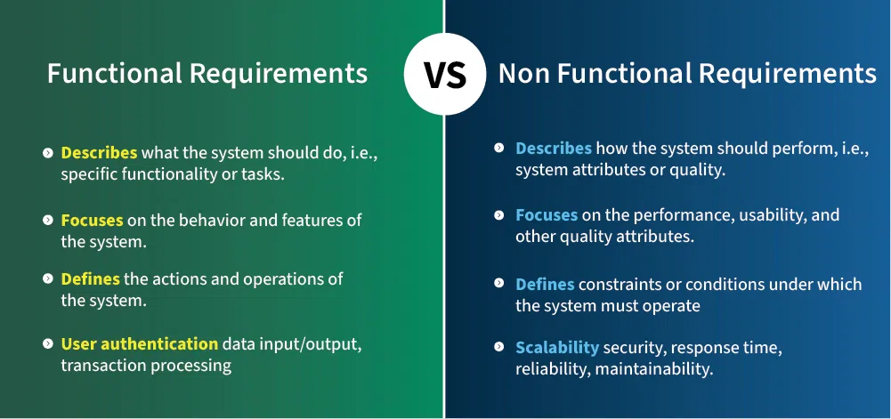
Key Differences:
Key Differences:

